Slide 1
Introduction to Geospatial Analysis
Key Concepts
Notes:
Second day:
MTN (non spatial)
Spatial analysis presentation
Practice with MTN Spatial (I go through)
Practice: have them do other things?

Slide 2
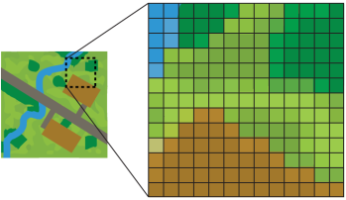
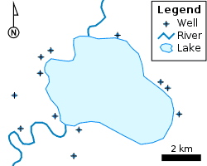
Spatial Data: Two main types of spatial data are vector data and raster data
Vector Data
Are points, lines, or polygons
Common file formats include shapefiles (.shp) and geojsons (.geojson)
Examples:
Polygons of countries
Polylines of roads
Points of households
Raster Data
Is a spatially referenced grid
Common file format is a geotif (.tif)
For example, satellite imagery comes in a raster format

Slide 3
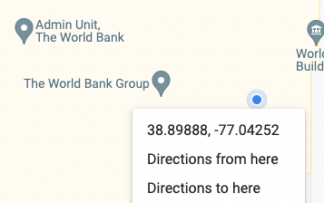
Coordinate Reference Systems (CRS)
Coordinate reference systems use pairs of numbers to define a location on the earth
For example, the World Bank is at a latitude of 38.89 and a longitude of -77.04

Slide 4
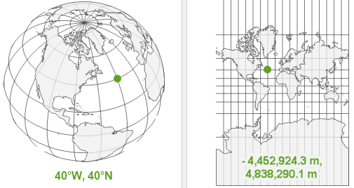
Coordinate Reference Systems
There are many different coordinate reference systems, which can be grouped into geographic and projected coordinate reference systems. Geographic systems live on a sphere, while projected systems are “projected” onto a flat surface.
Geographic (Sphere)
Projected (Flat)

Slide 5
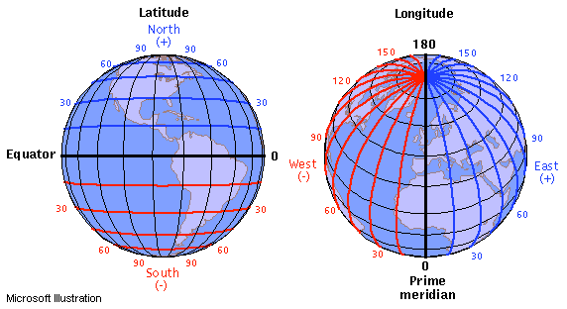
Geographic Coordinate Systems
Units: Defined by latitude and longitude, which measure angles and units are typically in decimal degrees. (Eg, angle is latitude from the equator).
Latitude & Longitude: On a grid X = longitude, Y = latitude.
Sometimes represented as (longitude, latitude).
Also has become convention to report them in alphabetical order: (latitude, longitude) — such as in Google Maps.
Valid range of latitude: -90 to 90
Valid range of longitude: -180 to 180
{Tip} Latitude sounds (and looks!) like latter.

Slide 6
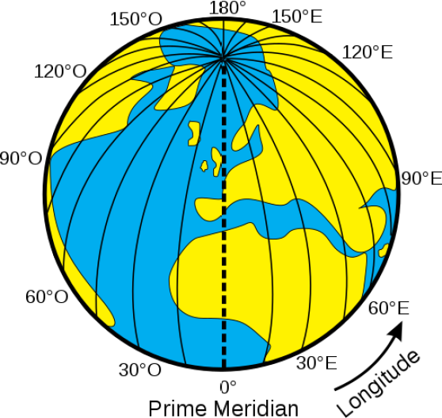
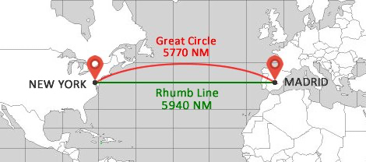
Geographic Coordinate Systems
Distance on a sphere
At the equator (latitude = 0), a 1 decimal degree longitude distance is about 111km; towards the poles (latitude = -90 or 90), a 1 decimal degree longitude distance converges to 0 km.
We must be careful (ie, use algorithms that account for a spherical earth) to calculate distances! The distance along a sphere is referred to as a great circle distance.

Slide 7
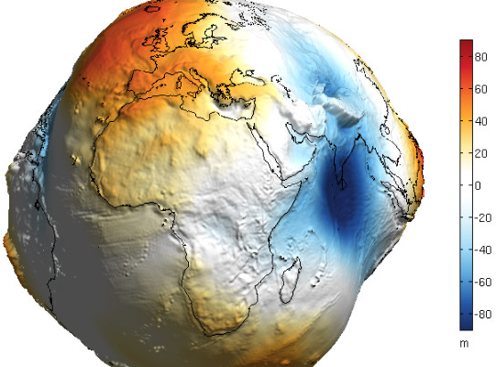
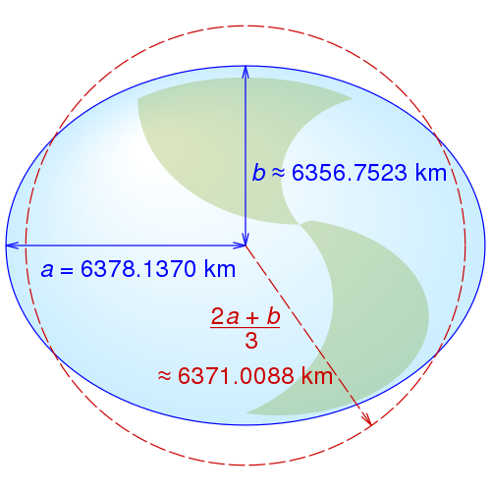
Geographic Coordinate Systems
Datums
Is the earth flat? No!
Is the earth a sphere? No!
Is the earth a lumpy ellipsoid? Yes!
The earth is a lumpy ellipsoid, a bit flattened at the poles.
A datum is a model of the earth that is used in mapping. One of the most common datums is WGS 84, which is used by the Global Positional System (GPS).
A datum is a reference ellipsoid that approximates the shape of the earth.
Other datums exist, and the latitude and longitude values for a specific location will be different depending on the datum.
Notes:
References:
* https://mgimond.github.io/Spatial/chp09_0.html

Slide 8

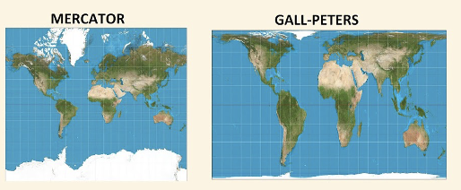
Projected Coordinate Systems
Click here to see why Toby & CJ are confused (hint: projections!)
Projected coordinate systems project spatial data from a 3D to 2D surface.
Distortions: Projections will distort some combination of distance, area, shape or direction. Different projections can minimize distorting some aspect at the expense of others.
Units: When projected, points are represented as “northings” and “eastings.” Values are often represented in meters, where northings/eastings are the meter distance from some reference point. Consequently, values can be very large!
Notes:
References:
* https://mgimond.github.io/Spatial/chp09_0.html

Slide 9
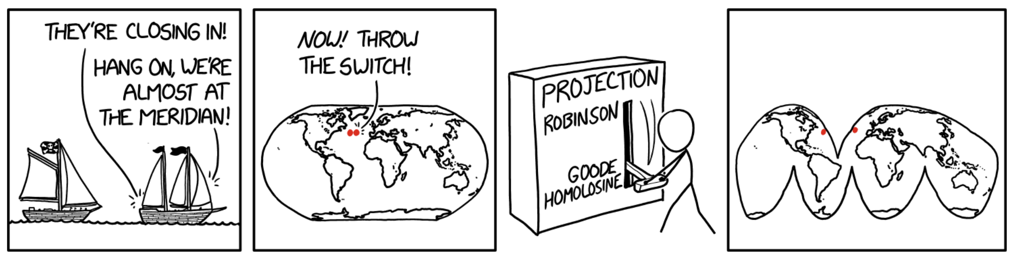
Projected Coordinate Systems
Notes:
More Funny Things
https://xkcd.com/977/
https://xkcd.com/2489/

Slide 10
Coordinate Reference Systems
Whenever have spatial data, need to know which coordinate reference system (CRS) the data is in.
You wouldn’t say “I am 5 away”
You would say “I am 5 [miles / kilometers / minutes / hours] away” (units!)
Similarly, a “complete” way to describe location would be: I am at 6.51 latitude, 3.52 longitude using the WGS 84 CRS

Slide 11
Referencing Coordinate Reference Systems
Coordinate reference systems can be referenced in multiple ways.
PROJ: One standard way of referencing CRSs is defined by PROJ (a CRS library):
WGS 84: +proj=longlat +datum=WGS84 +no_defs +type=crs
Mercator Projection: +proj=merc +lat_ts=0 +lon_0=0 +x_0=0 +y_0=0 +R=6371000 +units=m +no_defs +type=crs
EPSG: PROJ (and other systems) can be cumbersome. The European Petroleum Survey Group (EPSG) publishes a database of CRSs that provides a numeric ID to each CRS:
WGS 84: EPSG:4326
Mercator Projection: EPSG:53004
Notes:
References:
* https://r-spatial.org/book/02-Spaces.html

